Slide 1
Enzymes
By: Dr. Kalpana Jorasia
(Assistant Professor)
(Veterinary Biochemistry)

Slide 2
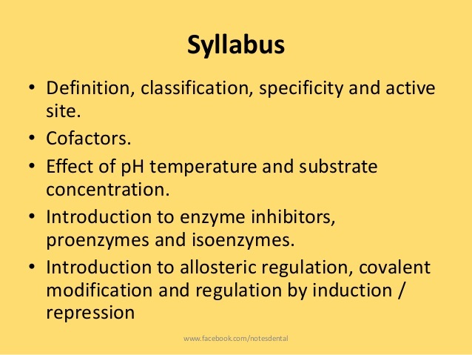

Slide 3
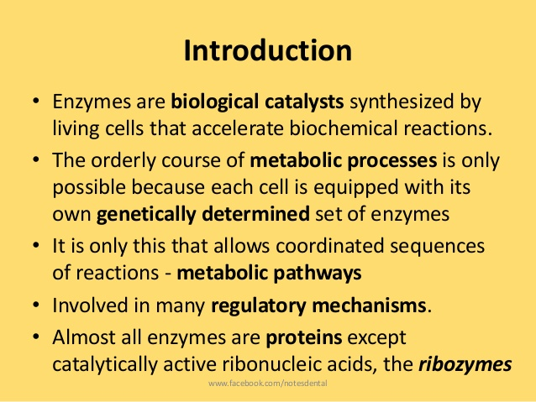
A catalyst is defined as a substance that increases the velocity or rate of chemical reaction without itself undergoing any change in the overall process.
Enzymes are biocatalysts synthesized by living cells. They are protein in nature (except-RNA acting as ribozyme), colloidal and thermolabile in character, and specific in their action

Slide 4
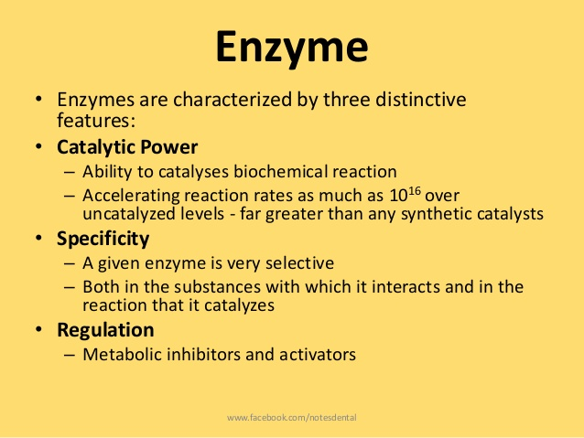
In lab. hydrolysis of proteins by a strong acid at 100ºC takes at least a couple of days.
The same protein is fully digested by the enzymes in gastrointestinal tract at 37 ºC) within a couple of hours.

Slide 5
HISTORY
In the 1850s, Louis Pasteur concluded fermentation of sugar into alcohol by yeast is catalyzed by ferments.
These ferments inseparable from living yeast cells this called vitalism.
Berzelius coined the term catalysis.
In 1897 Eduard Buchner discovered the yeast extracts ferment sugar to alcohol.
Frederick W. Kuhne gave the name enzymes to the molecules detected by Buchner.
The isolation and crystallization of urease by James Sumner in 1926 was a breakthrough in early enzyme studies.

Slide 6
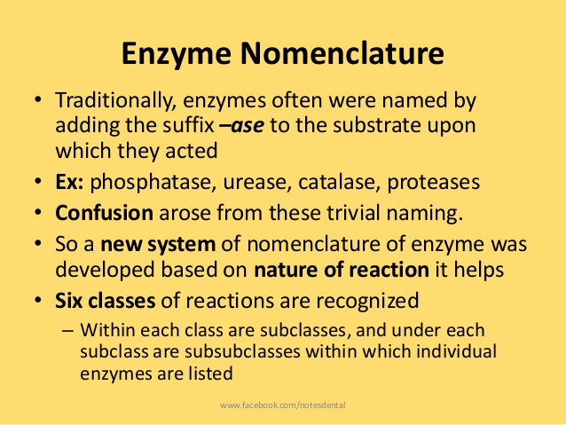

Slide 7
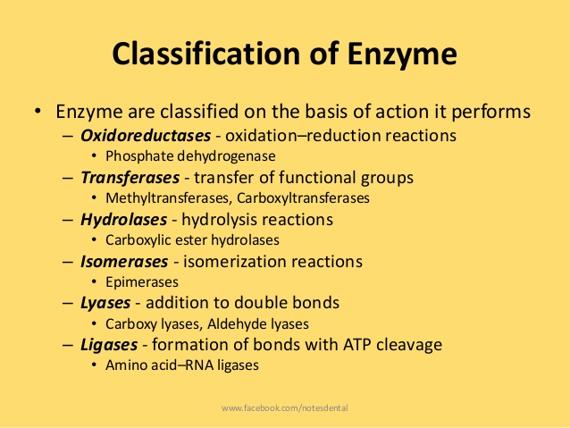
OTHLIL

Slide 8
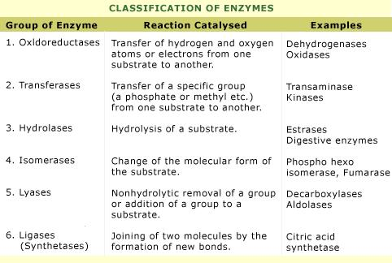

Slide 9
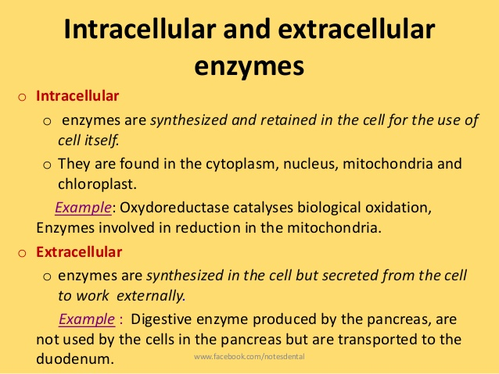

Slide 10
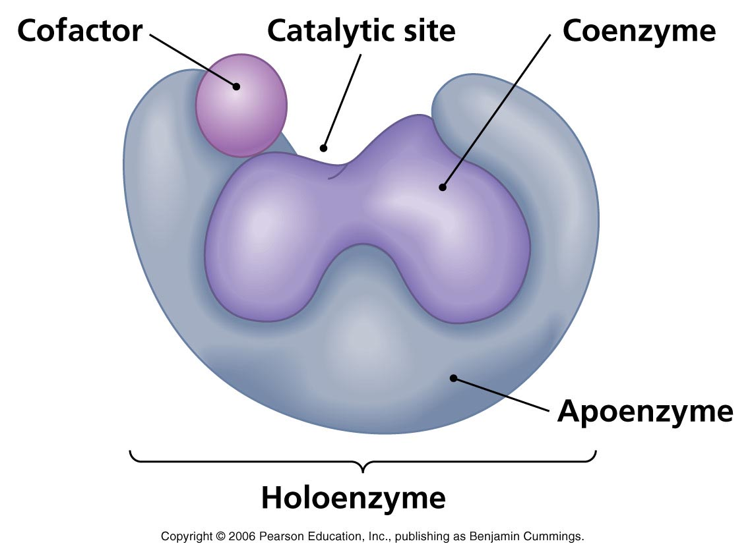
Properties Of Enzymes
The functional unit of the enzyme is known as holoenzyme.
Holoenzyme made up of apoenzyme (protein part) and coenzyme (non-protein organic part).
The term prosthetic group is used when the non-protein moiety covalently binds with the apoenzyme.
The coenzyme can be separated by dialysis from the enzyme.
The prosthetic group cannot be separated by dialysis from the enzyme.

Slide 11
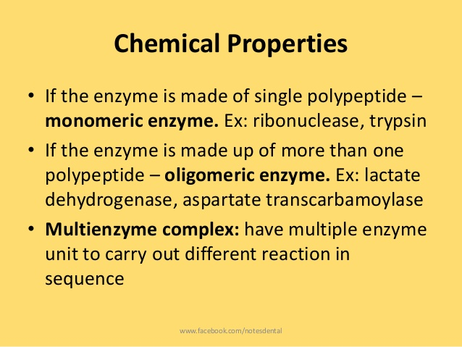

Slide 12
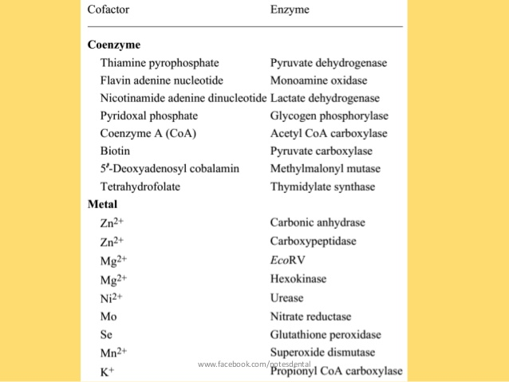

Slide 13
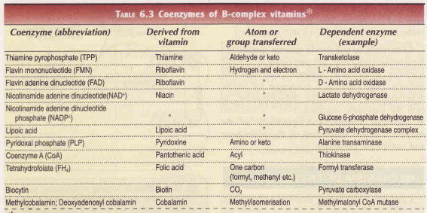

Slide 14
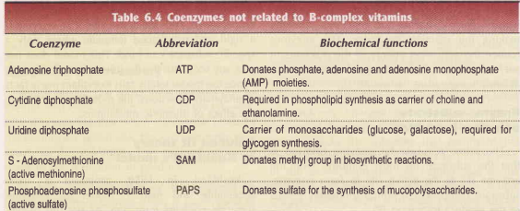

Slide 15
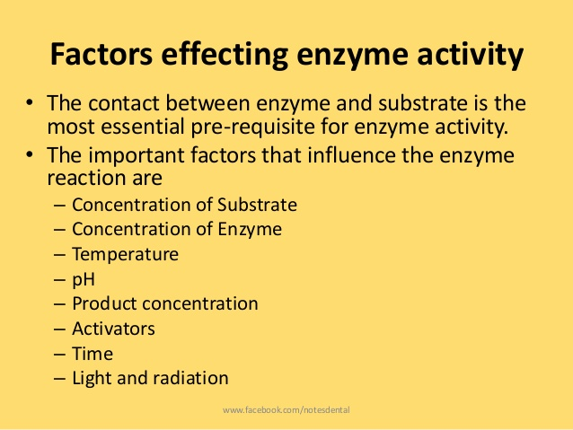

Slide 16
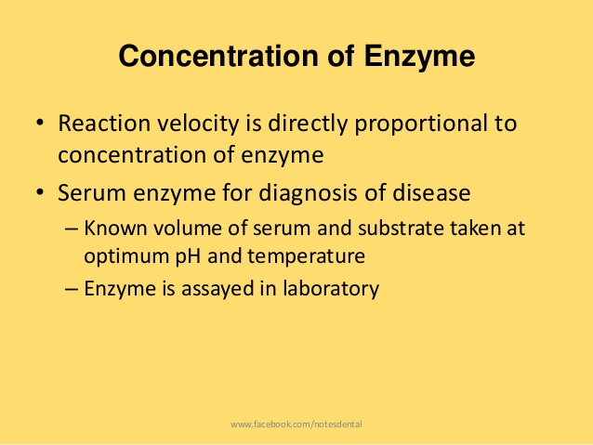
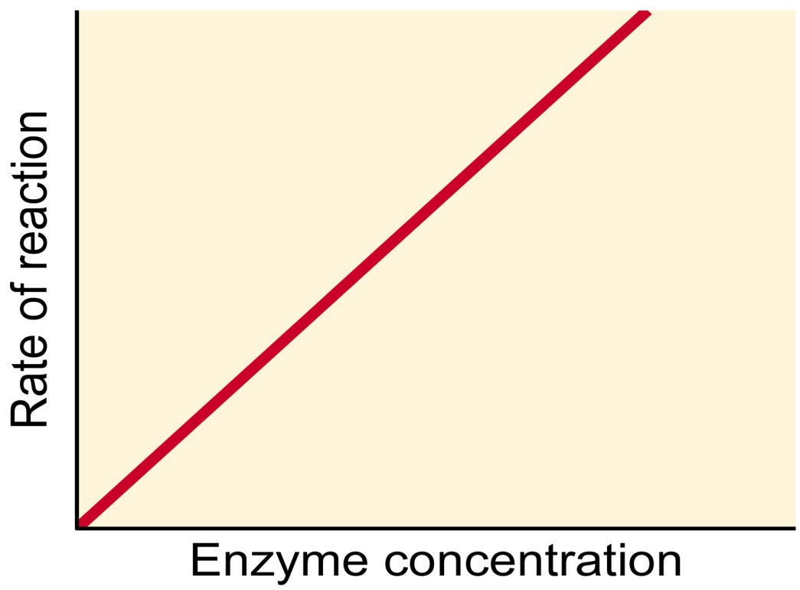
Straight line

Slide 17
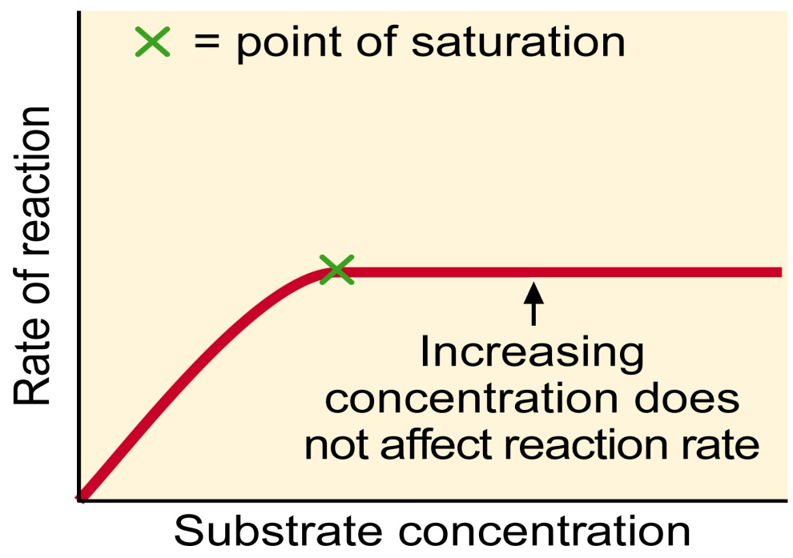
Concentration of substrate
Increase in substrate concentration gradually increases velocity of enzyme reaction within limited range.
A rectangular hyperbola is obtained when velocity plotted against substrate concentration.

Slide 18
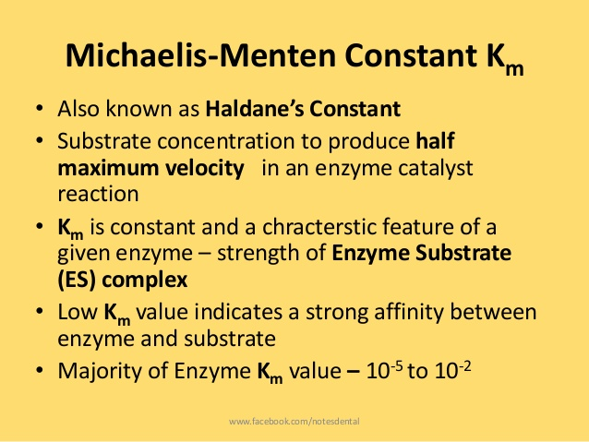
Brig’s constant

Slide 19
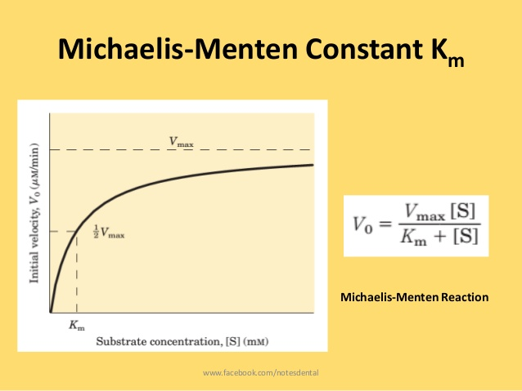
Km= [S]
It indicates that half of the enzyme molecules(50%) are bound with the substrate molecules when the substrate concentration equals the Km value.
Km value is not dependent on the concentration of enzyme.

Slide 20
When the velocity of the reaction is almost proportional to the substrate concentration( i.e. [S] is less than Km).
The rate of reaction is said to be first order with respect to substrate.
When [S] is much greater than Km rate of reaction is independent of substrate concentration.
Reaction is said to be zero order.

Slide 21
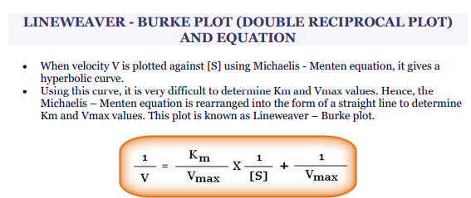
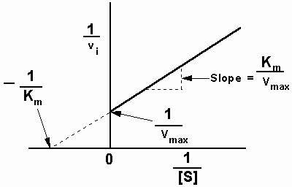
t
tttttthwshqhqsq
The double reciprocal plot is useful in understanding the effect of various inhibitors

Slide 22
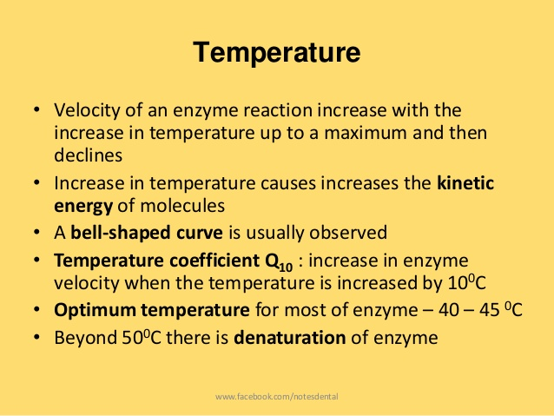
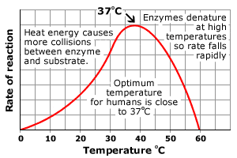

Slide 23
In general, when the enzymes are exposed to a temperature above 50ºC undergo denaturation.
Denaturation leading to derangement in tertiary structure.
Majority of the enzymes become inactive at higher temperature above 70ºC.

Slide 24
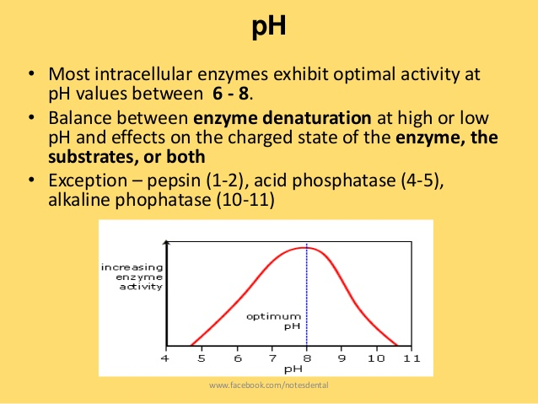
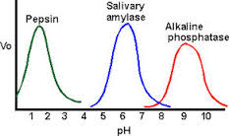

Slide 25
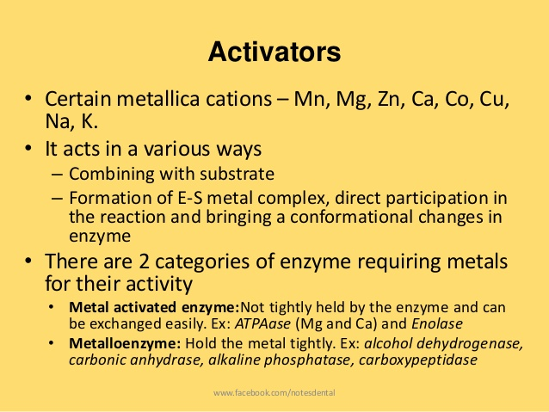

Slide 26
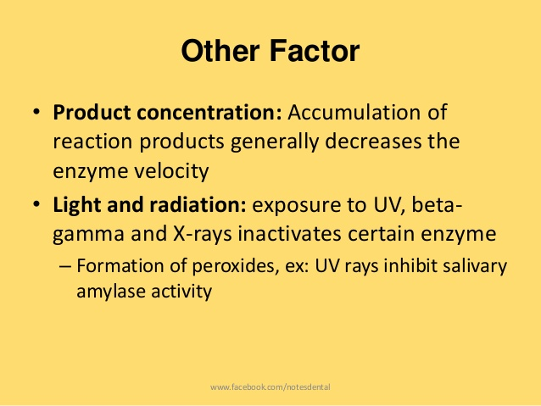

Slide 27
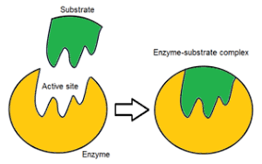

Slide 28
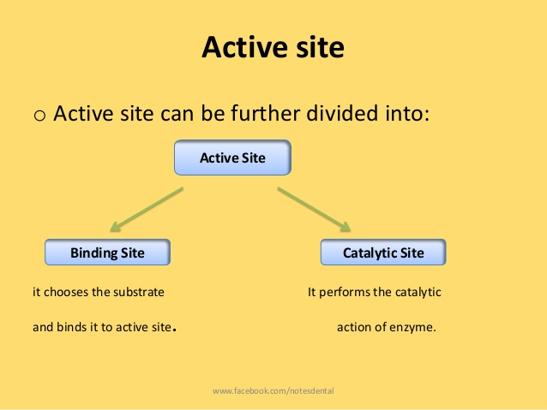
MODERN CONCEPT ABOUT THE ACTIVE SITE OF THE ENZYME

Slide 29
Salient features of active site
The existence of active site is due to the tertiary structure of protein resulting in three dimensional native conformation.
The active site is made up of amino acids (known as catalytic residues)
Active sites are regarded as clefts or crevices or pockets occupying a small region in a big enzyme molecule.
The active site is not rigid in structure and shape. lt is rather flexible to promote the specific substrate binding.
The coenzymes or cofactors on which some enzymes depend are present as a part of the catalytic site.
The substrate(s) binds at the active site by weak noncovalent bonds to the existence of active sites.

Slide 30
The commonly found amino acids at the active sites are serine, aspartate, histidine,cysteine, lysine, arginine, glutamate, tyrosine etc.
Among these amino acids, serine is the most frequently found.

Slide 31
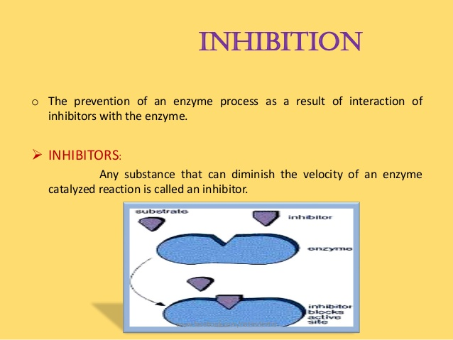

Slide 32
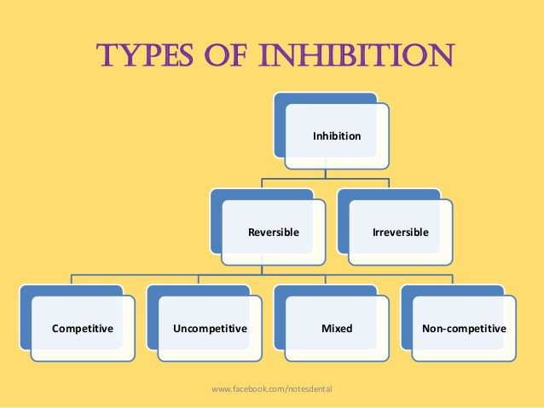

Slide 33
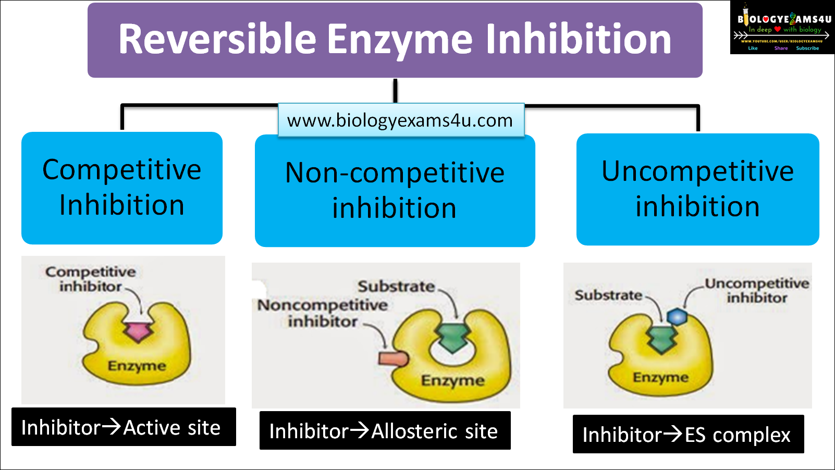

Slide 34
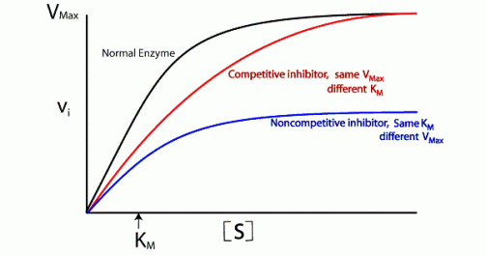

Slide 35
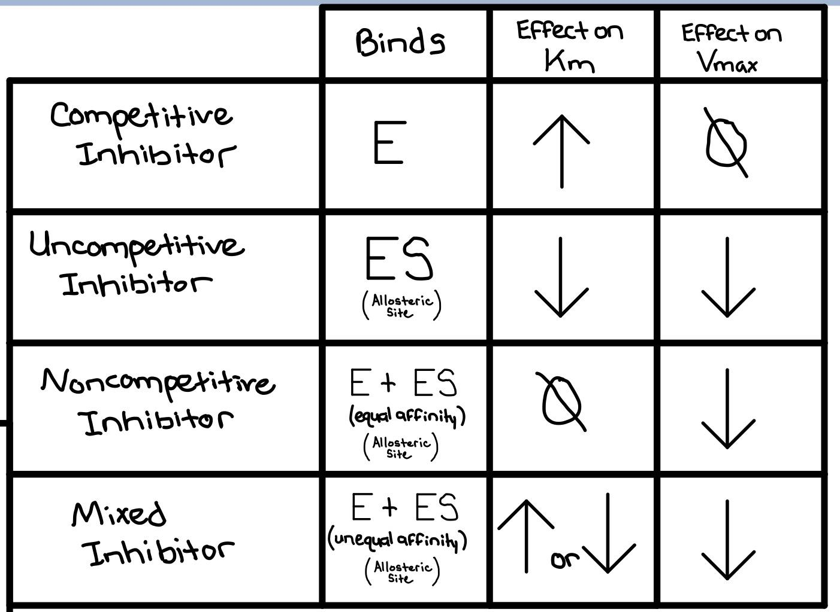

Slide 36
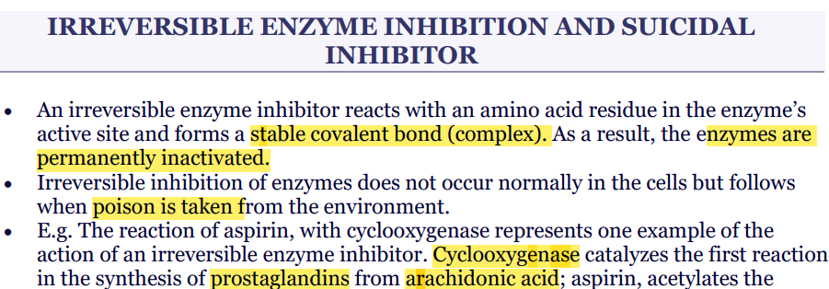

Slide 37
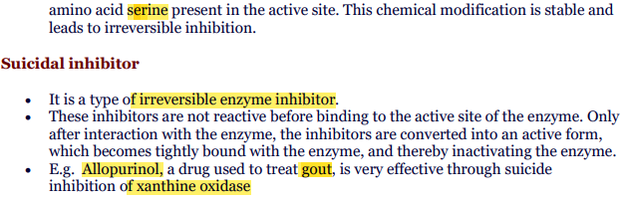

Slide 38
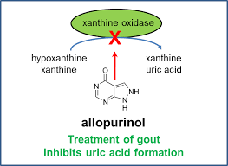

Slide 39
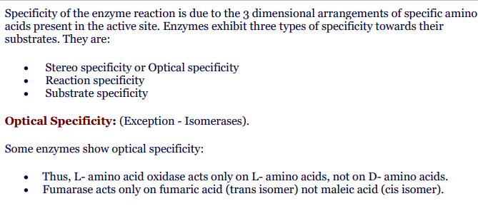
Enzyme Specificity

Slide 40
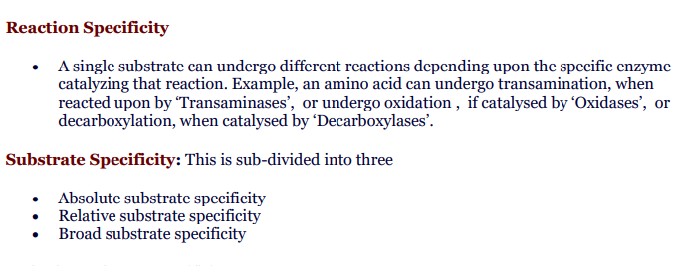

Slide 41
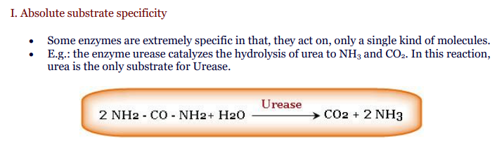

Slide 42
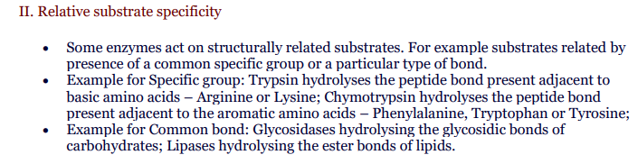

Slide 43
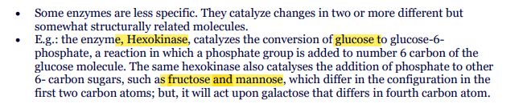
III. Broad substrate specificity

Slide 44
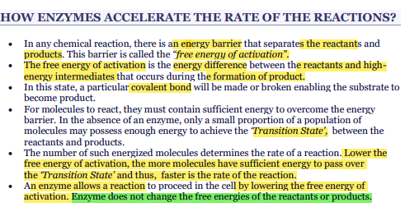

Slide 45
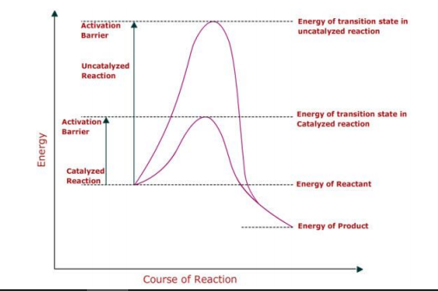

Slide 46
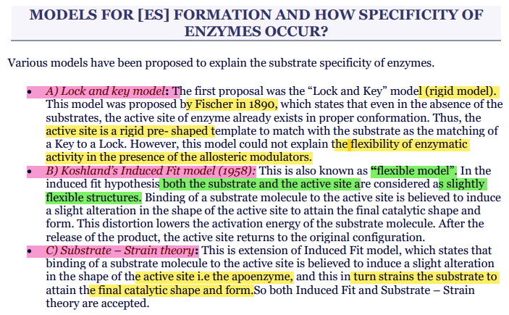

Slide 47
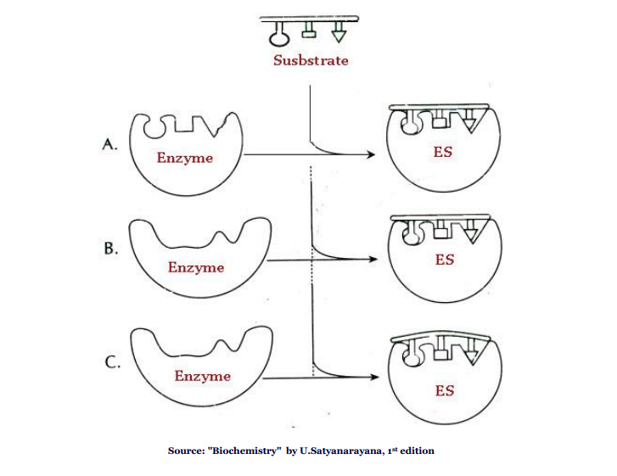

Slide 48
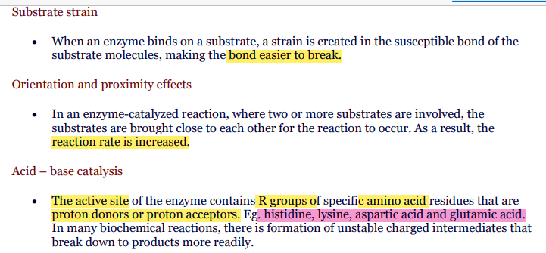
HOW ENZYMES LOWER THE ENERGY OF ACTIVATION

Slide 49
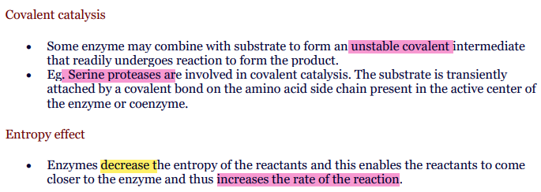

Slide 50
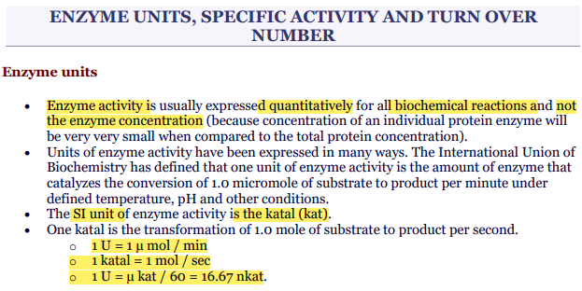

Slide 51
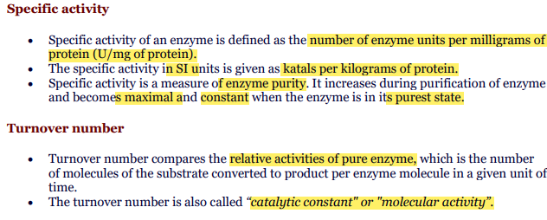

Slide 52
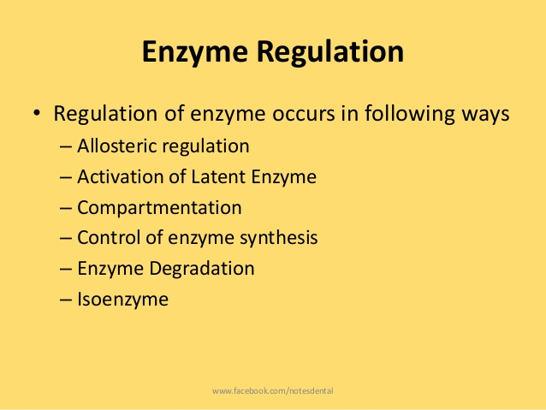

Slide 53
Allosteric regulation and allosteric inhibition
Additional sites other than active – Allosteric enzymes
Allosteric effectors : Certain substances referred to as allosteric modulators (effectors or modifiers) bind at the allosteric site and regulate the enzyme activity.
The enzyme activity is increased when a positive (+) allosteric effector binds at the allosteric site known as activator site.
A negative (-) allosteric effector binds at the allosteric site called inhibitor site and inhibits the enzyme activity

Slide 54
• Types of allosteric enzyme: – K-class: effectors changes the Km double reciprocal plot similar to competitive inhibition
– V-class: effectors changes the Vmax double reciprocal plot similar to non- competitive inhibition
•Most of allosteric enzymes are oligomeric in nature
•Non- covalent reversible binding of effector molecule at the allosteric sites – conformational change in the active site of enzyme

Slide 55



Slide 56


Slide 57

Feedback regulation
The process of inhibiting the first step by the final product, in a series of enzyme catalysed reactions of a metabolic pathway is referred to as feedback regulation
Feedback inhibition or end product inhibition is a specialised type of allosteric inhibition necessary to control metabolic pathways for efficient cellular function.

Slide 58
Activation of latent enzymes
Some enzymes remain inactive
Latent enzymes, as such, are inactive.
Some enzymes are synthesized as Proenzymes or zymogens which undergo irreversible covalent activation by the breakdown of one or more peptide bonds.
Examples :chymotrypsinogen, pepsinogen and plasminogen, converted to the active enzymes chymotrypsin, pepsin and plasmin.
Certain enzymes keeps interconverting from active to inactive and vice-versa depending on the need of body.The interconversion is brought about by the reversible covalent modifications, namely phosphorylation and dephosphorylation, and oxidation and reduction of disulfide bonds

Slide 59


Slide 60


Slide 61


Slide 62


Slide 63
Some important points
Km(michalis- menten constant)- not dependent on concentration of enzymes.
The double reciprocal plot/the double reciprocal plot is useful in understanding the effect of various inhibitions
Factors affecting enzyme activity
concentration of substrate- rectangular hyperbola
concentration of enzyme-straight line
concentration of temperature and pH- bell shaped
Allosteric enzymes do not follow michalies menten kinetics and formation of sigmoid curve.
Reversible inhibition- inhibition binds non covalently with enzymes.
Non-Reversible inhibition- inhibition binds covalently with enzymes and inactivates them.

Slide 64
Clinical Enzymology
Diagnostic importance of non functional plasma enzymes
and
Isoenzymes

Slide 65


Slide 66


Slide 67


Slide 68

serum enzymes are conveniently used as biomarkers to detect the cellular damage which ultimately helps in the diagnosis of diseases.

Slide 69
The digestive enzymes of the gastrointestinal tract (e.g. amylase, pepsin, trypsin, lipase etc.)present in the plasma are known as secretory enzymes.
All the other plasma enzymes associated with metabolism of the cell are collectively referred to as constitutive enzymes(e.g. lactate dehydrogenase, transaminases, acid and alkaline phosphatases, creatine phosphokinase).

Slide 70


Slide 71


Slide 72


Slide 73

Isoenzymes
The multiple forms of an enzyme catalysing the same reaction are isoenzymes or isozymes.
They, however, differ in their
physical and chemical properties which include the structure,
electrophoretic and immunological properties,
Km and Vmax values,
pH optimum,
relative susceptibility to inhibitors and
degree of denaturation.
Ex: hexokinase - 4, lactate dehydrogenase (LDH) – 5, creatinine phosphate (CPK) - 3 , creatinine kinase (CK) - 3, Alkaline phosphate (ALP) – 6, Alcohol dehydrogenase (ADH) -

Slide 74


Slide 75


Slide 76


Slide 77


Slide 78


